Slide 1







INFOSYS SPRINGBOARD INTERNSHIP
Medical Operations Intelligence Dashboard
Milestone 1 Review — Team Introduction & Dataset Overview
TEAM MEMBERS
DATASET OVERVIEW
Devashri Pavle
Neha Deshmukh
Synthetic Healthcare Dataset
Sayali Devkar
Kancharla Jahnavi
5,000
Vedika Pandey
Name Placeholder
PATIENT RECORDS · 6 LINKED TABLES
Neha Kumari
Name Placeholder
Patient
Admission
Doctor
Manoj Kumar
Name Placeholder
Staff
Bed
Billing
Privacy-safe, realistic hospital simulation built for operational analytics and dashboarding.
Infosys Springboard | Medical Operations Intelligence Dashboard | Milestone 1 Review
1

Slide 2







Milestone 1 Objectives
Building the foundation for healthcare operations analytics
OBJECTIVES
EXPECTED DELIVERABLES
Collect healthcare operational datasets
Clean Dataset
Clean and preprocess datasets
Integrated Healthcare Database
Standardize healthcare data
KPI-Ready Data
Integrate multiple healthcare tables
Prepare data for dashboard analytics
Documentation
PROCESS FLOW
Collect
Clean
Integrate
Validate
Analytics
Infosys Springboard | Medical Operations Intelligence Dashboard | Milestone 1 Review
2

Slide 3
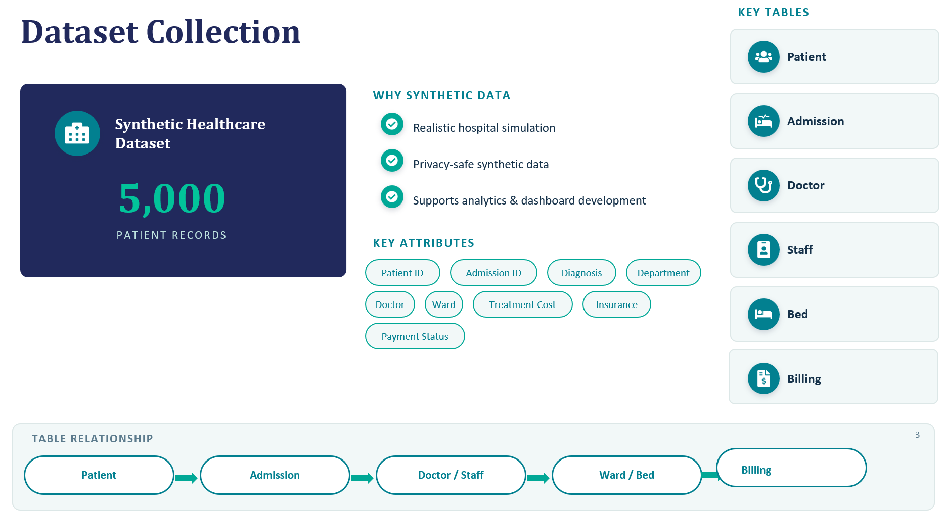

Slide 4




Data Cleaning & Preparation
Raw Data
Cleaning
Validation
Final Dataset
Synthetic Data Generation
Data Standardization
Data Validation
5,000 records generated with Faker using Indian demographic details
Standardized Admission_Date, Discharge_Date, Contact_no
Unique IDs across Patients, Admissions, Doctors, Staff, Beds & Bills
Business Rule Verification
Data Consistency
Quality Assurance
Paid Amount ≤ Total Amount · Insurance + Paid Amount = Total Amount
Verified consistency between Total Amount, Insurance Coverage and Paid Amount
No missing values · no duplicate IDs · consistent relationships
TOOLS USED
Python
Pandas
Faker
Random Module
4
Infosys Springboard | Medical Operations Intelligence Dashboard | Milestone 1 Review

Slide 5




Progressive Results — KPI Dashboard
Live KPIs generated from the integrated healthcare dataset (5,000 records)
5,000
56.9%
₹53.1 Cr
22.9%
Total Admissions
Bed Occupancy
Total Revenue
Collection Rate
ADMISSIONS TREND — LAST 12 MONTHS
BED TYPE DISTRIBUTION
Female
Male
Payment Status
2,506 (50.1%)
2,494 (49.9%)
Pending: 3,965 · Paid: 1,035
Infosys Springboard | Medical Operations Intelligence Dashboard | Milestone 1 Review
5

Slide 6


Challenges & Solutions
CHALLENGE
SOLUTION
Maintaining realistic healthcare relationships
Implemented business rule verification
Duplicate & inconsistent records
Used unique IDs and validation checks
Integrating multiple datasets
Used common keys and Pandas merge
Generating realistic healthcare data
Used Faker with logical randomization
Infosys Springboard | Medical Operations Intelligence Dashboard | Milestone 1 Review
6

Slide 7




Key Learnings
TOPICS LEARNED
HOW THIS HELPS THE NEXT MILESTONE
Python Data Processing
Dashboard Creation
Pandas Data Manipulation
KPI Calculation
Synthetic Data Generation
Data Visualization
Data Validation
Data Integration
Better Analytics
GitHub Collaboration
Infosys Springboard | Medical Operations Intelligence Dashboard | Milestone 1 Review
7

Slide 8



Team Collaboration
TASK DISTRIBUTION
GITHUB WORKFLOW
Dataset Creation
Feature Branch
Data Cleaning
Development
Data Integration
Pull Request
Documentation
Review
GitHub Management
Merge
VERSION CONTROL PRACTICES
GitHub
Branch-based Development
Pull Requests
Team Collaboration
Infosys Springboard | Medical Operations Intelligence Dashboard | Milestone 1 Review
8

Slide 9
Conclusion
MILESTONE 1 — COMPLETED
NEXT MILESTONE
Dataset collected
Patient Flow Analysis
Data cleaned
Data standardized
Service Demand Intelligence
Healthcare tables integrated
Operational KPI Dashboards
Quality validation completed
Interactive Visualizations
Foundation ready for analytics
Milestone 1 established a clean, reliable and analytics-ready healthcare dataset — the foundation for the Medical Operations Dashboard.
Foundation Ready for Analytics
Infosys Springboard | Medical Operations Intelligence Dashboard | Milestone 1 Review
9

